Slide 1
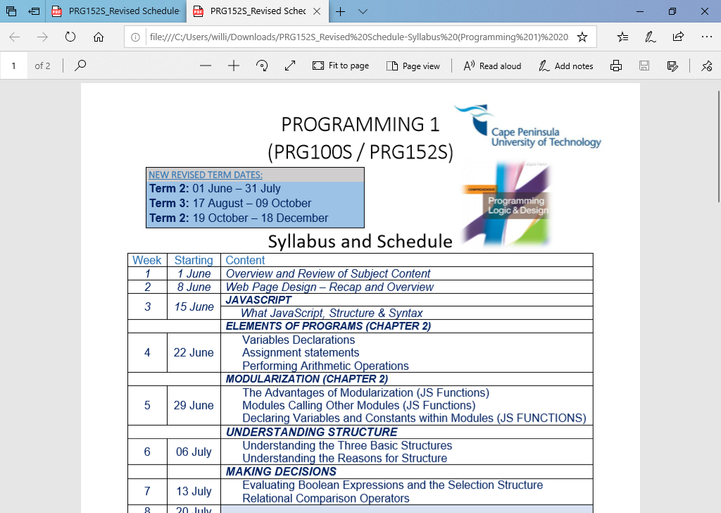
Website & JavaScript Features
PROGRAMMING 1 ONLINE CLASS
21 October 2020

Slide 2
Agenda
Login Forms
Form Validation
Javascript JSON – data elements

Slide 3
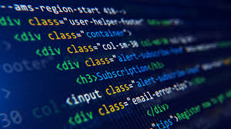
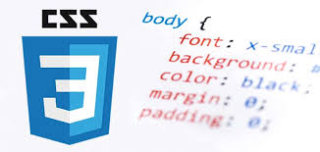
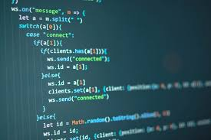
Login Forms
HTML
CSS
JS

Slide 4
HTML
<body>
<h2>Login Form</h2>
<form action="/action_page.php" method="post">
<div class="imgcontainer">
<img src="img_avatar2.png" alt="Avatar" class="avatar">
</div>
…..
</form>
</body>

Slide 5
CSS
body {font-family: Arial, Helvetica, sans-serif;}
form {border: 3px solid #f1f1f1;}
input[type=text], input[type=password] {
width: 100%;
padding: 12px 20px;
margin: 8px 0;
display: inline-block;
border: 1px solid #ccc;
box-sizing: border-box;
}
button {
background-color: #4CAF50;
color: white;
padding: 14px 20px;
margin: 8px 0;
border: none;
cursor: pointer;
width: 100%;
}
button:hover {
opacity: 0.8;
}

Slide 6
JavaScript
The Actions to be taken when for instance:
A button is pressed
Is normally called as a function
Validate()
onclick is an attribute of a button element
Eg. (The line below appears in the html section)
<input type="button" value="Login" id="submit" onclick="validate()"/>

Slide 7
JSON What is JSON?
JSON stands for JavaScript Object Notation
JSON is a lightweight data interchange format
JSON is language independent *
JSON is "self-describing" and easy to understand
JSON is used to store information in an organized, and easy-to-access manner. Its full form is JavaScript Object Notation. It offers a human-readable collection of data which can be accessed logically.

Slide 8
JSON Syntax
var json-object-name = { string : number_value,......}
Example
var emp = {name: “Sally”,
“Salary”: 2600,
“depart”: “Sales”,
active: true}
Rules for JSON Syntax
Data should be in name/value pairs
Data should be separated by commas
Curly braces should hold objects
Square brackets hold arrays

Slide 9
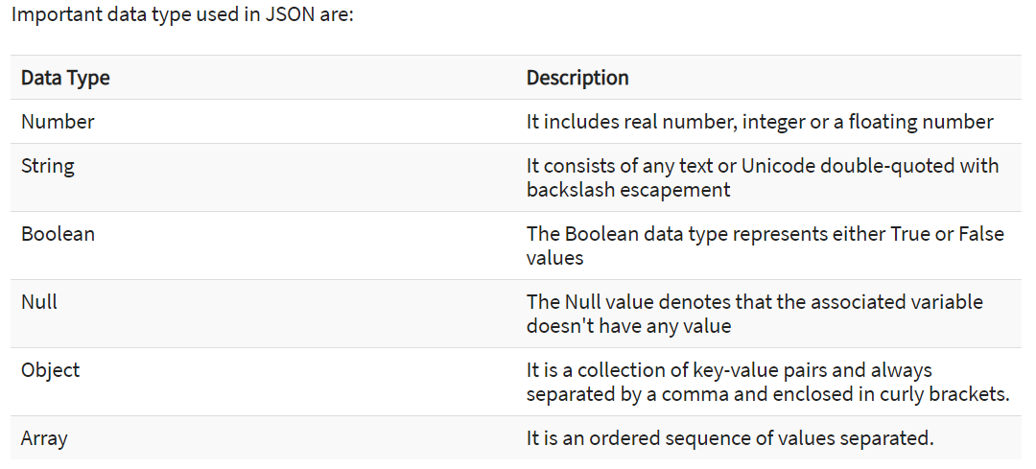
Data Types in JSON

Slide 10
Example - Write to page content
var myJSON = '{"name":"John",
"age":31,
"city":"New York"}';
document.getElementById("demo").innerHTML = myObj.name;

Slide 11
JSON Arrays
Syntax
jsonObj = {“ArrayObj”: [ {“field1” : “value”,
“field2” : “value”,
“field3” : “value”, ….},
{“field1” : “value”,
“field2” : “value”,
“field3” : “value”, ….},
]
}

Slide 12
JSON Array
Example
EmpObj = { [ {name: “Sally”,
“Salary”: 2600,
“depart”: “Sales”,
active: true,},
{name: “Peter”,
“Salary”: 1950,
“depart”: “Transport”,
active: true,},
]
}
document.getElementById("demo").innerHTML = EmpObj[1].name;

Slide 13
JSON Array – more complete example
<!DOCTYPE html>
<html>
<body>
<p>Looping through arrays inside arrays.</p>
<p id="demo"></p>
<script>
var myObj, i, j, x = "";
myObj = {
"name":"John",
"age":30,
"cars": [
{"name":"Ford", "models":["Fiesta", "Focus", "Mustang"]},
{"name":"BMW", "models":["320", "X3", "X5"]},
{"name":"Fiat", "models":["500", "Panda"] }
]
}
for (i in myObj.cars) {
x += "<h2>" + myObj.cars[i].name + "</h2>";
for (j in myObj.cars[i].models) {
x += myObj.cars[i].models[j] + "<br>";
}
}
document.getElementById("demo").innerHTML = x;
</script>
</body>
</html>

Slide 14
External JSON Files
JSON Data File (data.json)
EmpObj = { [ {name: “Sally”, “Salary”: 2600, “depart”: “Sales”, active: true,},
{name: “Peter”, “Salary”: 1950, “depart”: “Transport”, active: true,},
{name: “Frank”, “Salary”: 3700, “depart”: “Management”, active: true,},
]
}
HTML File (Test.html)
<head>
<script type="text/javascript" src="data.json"></script>
<script type="text/javascript" src="javascrip.js"></script>
</head>
<script>
var Employees = JSON.parse(EmpObj);
…..
</script>

